Slide 1

OWASP Top-10 2013
Dave Wichers
OWASP Top 10 Project Lead
OWASP Board Member
COO/Cofounder, Aspect Security

Slide 2
About the OWASP Top 10
OWASP Top 10 is an Awareness Document
Not a standard…
First developed in 2003
Was probably 3rd or 4th OWASP project, after
Developers Guide
WebGoat
Maybe WebScarab ??
Released
2003, 2004, 2007, 2010, 2013

Slide 3
OWASP Top Ten (2013 Edition)
A1: Injection
A10: Unvalidated Redirects and Forwards
A5: Security Misconfiguration
A3: Cross-Site Scripting (XSS)
A2: Broken Authentication and Session Management
A4: Insecure Direct Object References
A7: Missing Function Level Access Control
A6: Sensitive Data Exposure
A8: Cross Site Request Forgery (CSRF)
A9: Using Known Vulnerable Components
Notes:
A9 is the only new item in the top 10 for 2013.

Slide 4
What Didn’t Change
It’s About Risks, Not Just Vulnerabilities
OWASP Top 10 Risk Rating Methodology
Title is: “The Top 10 Most Critical Web Application Security Risks”
Based on the OWASP Risk Rating Methodology, used to prioritize Top 10

Slide 5
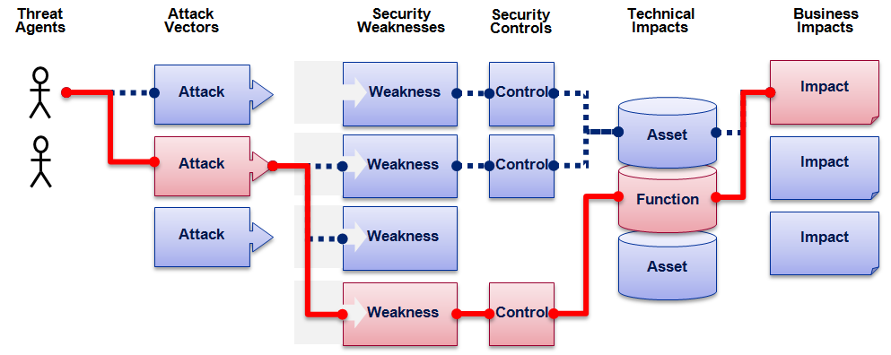

OWASP Top 10 Risk Rating Methodology
Threat Agent | Attack Vector | Weakness Prevalence | Weakness Detectability | Technical Impact | Business Impact
? | Easy | Widespread | Easy | Severe | ?
 | Average | Common | Average | Moderate
 | Difficult | Uncommon | Difficult | Minor
 | 1 | 2 | 2 | 1
 |  | 1.66 | * | 1
1
2
3
Injection Example
1.66 weighted risk rating

Slide 6
What’s Changed?
Risks Added, Risks Merged, Risks Reordered
Reordered: 7
Added: 1
Merged: 2 merged into 1
Broadened: 1
Development Methodology For 2013
Same as 2010, but
Used more sources of vulnerability data
All vulnerability data made public by each provider
Development Methodology for Next Version?
More transparency
Requested vulnerability data format
Earlier community involvement

Slide 7
Mapping from 2010 to 2013 Top 10
OWASP Top 10 – 2010 (old) | OWASP Top 10 – 2013 (New)
2010-A1 – Injection | 2013-A1 – Injection
2010-A2 – Cross Site Scripting (XSS) | 2013-A2 – Broken Authentication and Session Management
2010-A3 – Broken Authentication and Session Management | 2013-A3 – Cross Site Scripting (XSS)
2010-A4 – Insecure Direct Object References | 2013-A4 – Insecure Direct Object References
2010-A5 – Cross Site Request Forgery (CSRF) | 2013-A5 – Security Misconfiguration
2010-A6 – Security Misconfiguration | 2013-A6 – Sensitive Data Exposure
2010-A7 – Insecure Cryptographic Storage | 2013-A7 – Missing Function Level Access Control
2010-A8 – Failure to Restrict URL Access | 2013-A8 – Cross-Site Request Forgery (CSRF)
2010-A9 – Insufficient Transport Layer Protection | 2013-A9 – Using Known Vulnerable Components (NEW)
2010-A10 – Unvalidated Redirects and Forwards (NEW) | 2013-A10 – Unvalidated Redirects and Forwards
3 Primary Changes: | Merged: 2010-A7 and 2010-A9 -> 2013-A6
Added New 2013-A9: Using Known Vulnerable Components | 2010-A8 broadened to 2013-A7
Notes:
Broken Auth and Session Management moved up, we believe, because more consulting organizations were included in this data set, and they can find this better than automated tools can. We don’t believe the actual prevalence of this issue increased, just the measured prevalence.
CSRF dropped we believe because organizations are getting a handle on this new issue that was first added to the Top 10 in 2007. The awareness the Top 10 raised, has helped reduce the prevalence of this issue (we believe).

Slide 8
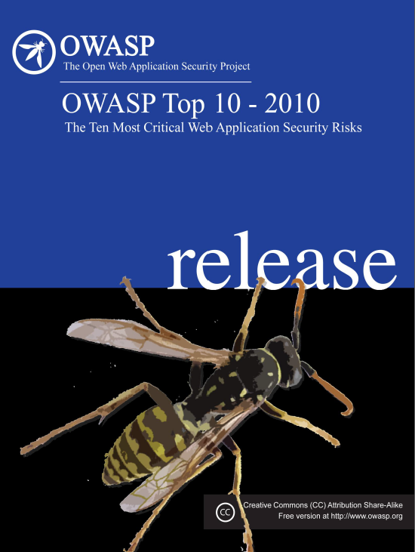
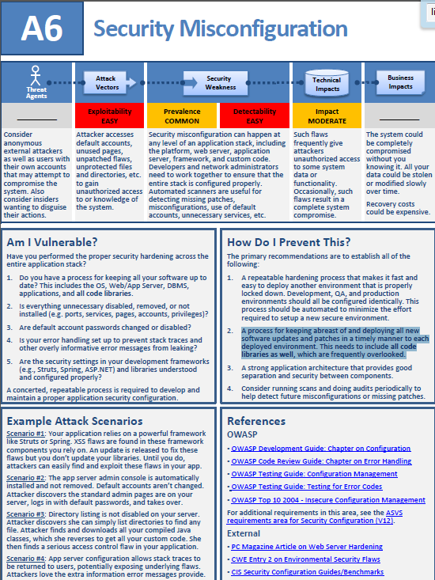
OWASP Top Ten 2010-A6 Security Misconfiguration
How Do I Prevent This?
The primary recommendations are to establish all of the following:
…
2. A process for keeping abreast of and deploying all new software updates and patches in a timely manner to each deployed environment. This needs to include all code libraries as well, which are frequently overlooked.”
Notes:
We pointed out vulnerable components as an issue in the 2010 Top 10 as part of A6. Now, it has its own category.

Slide 9

The amount of custom code
in an application hasn’t changed
very much in the past 10 years.
80% Libraries
But library use is growing at a staggering rate
Notes:
First of all you have to understand that over the past few years, software has become dominated by components.
Applications that used to be 200,000 lines of code are still 200,000 lines of code, but NOW, there are another 800,000 lines of code in the libraries and frameworks. Sometimes much more. Anybody use Hudson?

Slide 10
Transformation
20% Custom Code
80% Libraries
But library use is growing at a staggering rate
Notes:
Increasing “layer” in between your custom code and your application server. Nobody is focused on the security of this very important layer.

Slide 11
Everyone Uses Vulnerable Libraries
29 MILLION vulnerable downloads in 2011
Libraries | 31
Library Versions | 1,261
Organizations | 61,807
Downloads | 113,939,358
https://www.aspectsecurity.com/news/press/the-unfortunate-reality-of-insecure-libraries
Notes:
Aspect Security did a study with Sonatype about how many known vulnerable libraries were downloaded in 2011 from Maven central. By known vulnerable we mean, was there a known vulnerability in that library at the moment it was downloaded. Sonatype runs Maven central so was able to provide us with direct download stats that would otherwise be unavailable. We selected the top 26 or so most popular libraries and the top 5 most popular security libraries as the target of the study.

Slide 12
2013-A9 – Using Known Vulnerable Components
Vulnerable Components Are Common
Some vulnerable components (e.g., framework libraries) can be identified and exploited with automated tools
Widespread
Virtually every application has these issues because most development teams don’t focus on ensuring their components/libraries are up to date
Typical Impact
Full range of weaknesses is possible, including injection, broken access control, XSS ...
In many cases, the developers don’t even know all the components they are using, never mind their versions. Component dependencies make things even worse
This expands the threat agent pool beyond targeted attackers to include chaotic actors
The impact could range from minimal to complete host takeover and data compromise

Slide 13
What Can You Do to Avoid This?
Ideal
Automation checks periodically (e.g., nightly build) to see if your libraries are out of date
Even better, automation also tells you about known vulnerabilities
Minimum
By hand, periodically check to see if your libraries are out of date and upgrade those that are
If any are out of date, but you really don’t want to upgrade, check to see if there are any known security issues with these out of data libraries
If so, upgrade those
Could also
By hand, periodically check to see if any of your libraries have any known vulnerabilities at this time
Check CVE, other vuln repositories
If any do, update at least these

Slide 14
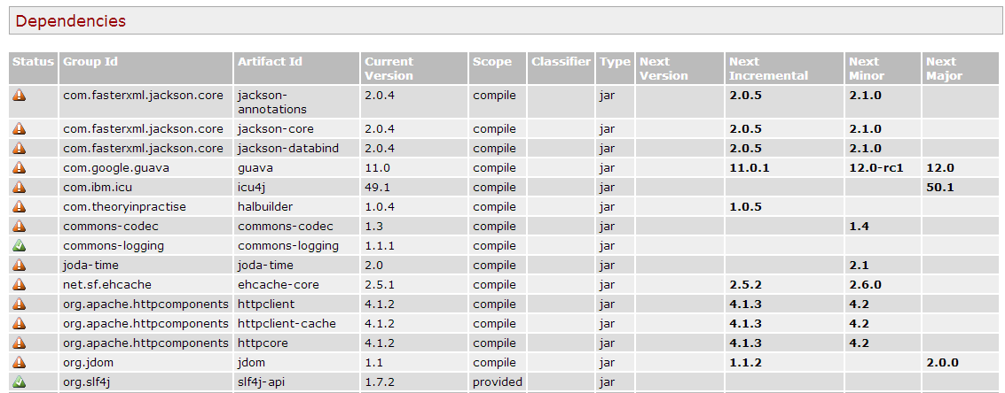
Automation Example for Java – Use Maven ‘Versions’ Plugin
Output from the Maven Versions Plugin – Automated Analysis of Libraries’ Status against Central repository
Most out of Date!
Details Developer Needs
This can automatically be run EVERY TIME software is built!!
Notes:
The Versions plugin is free. If you use Maven, you can have Versions run automatically on the libraries used by your project. Versions will tell you if that library is using the latest version available in Maven central, and if not, what new versions are available. It doesn’t provide any vulnerability information, but at least automatically can tell you if your libraries are out of date.

Slide 15
The Merged 2013-A6 – Sensitive Data Exposure
Storing and Transmitting Sensitive Data Insecurely
Failure to identify all sensitive data
Failure to identify all the places that this sensitive data gets stored
Databases, files, directories, log files, backups, etc.
Failure to properly protect this data in every location
Failure to identify all the places that this sensitive data is sent
On the web, to backend databases, to business partners, internal communications
2010-A7 – Insecure Cryptographic Storage
Two Related Topics Merged
2010-A9 – Insufficient Transport Layer Protection
To make room for New 2013-A9: Using Known Vulnerable Components

Slide 16
Expanded 2013-A7 – Missing Function Level Access Control
Was: 2010-A8 – Failure to Restrict URL Access
URLs are one way to access functions
Expand to Cover all Ways a Function Can Be Accessed
URL to function directly
URL plus parameter value(s) which indicate which function is being accessed
e.g., site/somedir/somepage?action=transferfunds
Typical Flaws
Application simply doesn’t check to see if function invocation is authorized
Application does check for authorization, but check is flawed. (This would be broken function level access control, but missing is far more common.)
But not the only way …

Slide 17
OWASP Top 10 2013 Development Methodology
Gather Vulnerability Stats
Ask previous contributors, solicit new contributors well known to Top 10 team, include unsolicited volunteers
Analyze Stats, Produce Initial Draft, Release for Public Comment
Draft Released to OWASP Community Feb 15, 2013
Public Comment Period Open for 90+ days (thru May 30, 2013)
Final Release Produced
All Constructive Comments Considered
Full documentation of Constructive Comments and how they were addressed documented
New: Each provider asked to make their data public. All Did.
3 New Data Contributors Included: TrustWave, Veracode, Minded Security
Released on June 12, 2013
https://www.owasp.org/images/3/3d/OWASP_Top_10_-_2013_Final_Release_-_Change_Log.docx

Slide 18
OWASP Top 10 Future Development Methodology Ideas
Gather More Stats More Openly
Issue Open Call For Vulnerability Stats Providers
Consider Other Stats if They Make Sense
We only have Vulnerability Prevalence Stats
What about Stats for Exploitability, Detectability, Impact?
Expand Authoring Team
Solicit Additional Volunteers
Consider all Stats Provided by Requested Deadline
Provide Desired Stats Format (for consistency) and Require Public Reporting
Don’t Ignore Future Looking Threats
Like we did with CSRF in 2007, and Vulnerable Components in 2013
We tried to consider some Exploitability stats in 2013, but couldn’t find effective public stats

Slide 19
OWASP Top 10 Resources
Video Presentation of Each Item in OWASP Top 10 – 2010 (which is very similar)
Dave Wichers at OWASP AppSec DC (2009)
http://www.vimeo.com/9006276
OWASP Top 10 – 2013 Presentation which goes through each item one by one
https://www.owasp.org/index.php/Top10
Translations of OWASP Top 10 - 2013
French, Chinese, and Korean Translations complete
Many others are underway
https://www.owasp.org/index.php/Top10#tab=Translation_Efforts

Slide 20
Thank you OWASP Top-10 Project

